Slide 1
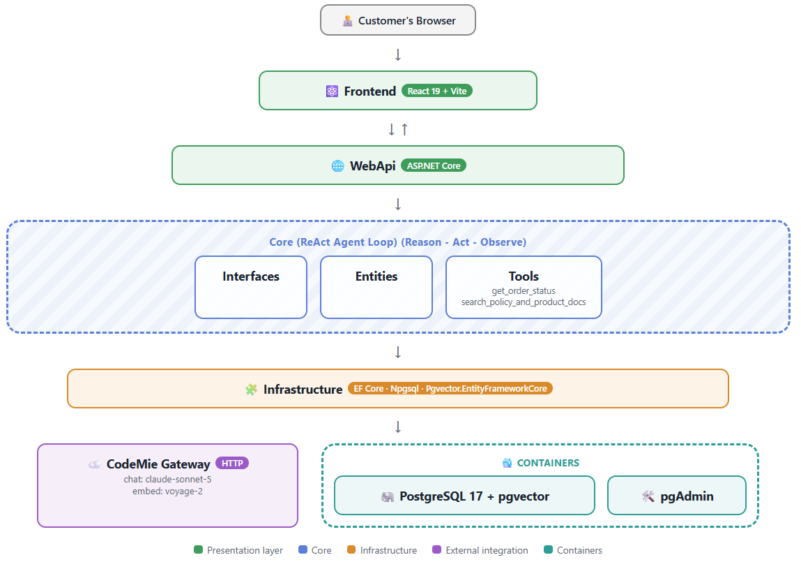
AI UPSKILL · July 2026
3-WEEK INITIATIVE
AI Shopping Assistant Chat Bot
TEAM
INTRODUCTION
OTHERS
WAEL ELQAMASH
.NET
An AI chat assistant that gives e-commerce customers instant, accurate answers about their orders, deliveries, and policies by combining live order lookup with semantic search over policy/product docs — grounding every answer in real data and escalating to a human when it can't confidently resolve a request.
IMPACT
Creating complete AI chat bot in a very small amount of time.
SOLUTION
[ Architecture Diagram ]
TECH STACK
LEARNINGS
.NET
Postgres + pgvector
pgAdmin
I learned creating workflows with N8n.
I learned using SDD with SpecKit.
I learned new knowledge about AI.
Codemie
Codemie-claude
SpecKit
React
NEXT STEPS
Reviewing generated code to find problems to fix or enhancements that can be done.
BUSINESS CHALLENGES
Solution: Tech Stack & Architecture
Stack: .NET 10 + EF Core, React 19/Vite, PostgreSQL 17 + pgvector, CodeMie gateway → Claude Sonnet 5 + Voyage-2 embeddings, in a layered architecture with a ReAct agent loop
- Integration:
- Design decisions: vector + relational data live in one Postgres schema (pgvector) rather than a separate vector store. Using Codemie to facilitate working with speckit and Claude sonnet and get use of EPAM API key provided to employees. React for light chat widget.
Customers shopping on an e-commerce platform frequently need quick answers that today require digging through multiple places: a "My Orders" page, a help center full of policy articles, and sometimes a support ticket queue.
ADDITIONAL NOTES
https://www.npmjs.com/package/@codemieai/code
.NET AI UPSKILL INITIATIVE — July 2026
CONFIDENTIAL

